Slide 1


SENTIMENTAL ANALYSIS ON
AMAZON PRODUCT REVIEW
Presented by: Group A
Muhammad Yaasir- C0906653
Soorya Gayathri- C0900929
Sandra Jolly Maria- C0891522
Vineet Pinjrotia- C0893355
Sandra Elizabeth- C0872108
Pawandeep Kaur- C0901263

Slide 2

PROJECT OVERVIEW
Objective
Automate sentiment analysis to filter and categorize Amazon product reviews.
Key Outcome
Improved customer experience by providing quick access to the most relevant reviews.
01
Key Goals
Automation of Review filtering using Sentiment Analysis for efficient search of products
Categorize reviews by sentiment and product features.
02
Impact on Amazon
Advances understanding of customer feedback.
Advanced Features
Introduce a review filtering feature that can sort out reviews.
Customers are assisted to get relevant reviews quickly.
Improves overall shopping experience on Amazon.
03

Slide 3



CODE WORKFLOW
1
2
3
4
DATA IMPORT AND INITIAL SETUP
DATA EXPLORATION
UNIQUE IDENTIFIERS
DATA VIZUALIZATION
Imported libraries like Pandas, NumPy, Matplotlib, Seaborn.
Read the dataset, amazon.csv into a DataFrame.
Applied warnings filters
Set up the visualization styles.
Action: Descriptive statistics using describe() method.
Purpose: Understand the basic statistical properties of the dataset.
Information: Checked data types using info().
Action: Extracted unique. asins (Amazon Standard Identification Numbers).
Purpose: Determine the number of unique products in the dataset
Action: Plotted histograms for reviews
Purpose: To visualize the distributions
Result: Visualized review ratings using a count plot.

Slide 4
INTEGRATION AND DEPLOYMENT
Model Training
Data Preparation:
Split data into training and test sets using StratifiedShuffleSplit.
Sentiment Labeling:
Defined a sentiments() function to categorize reviews as "Positive," "Neutral," or "Negative" based on ratings.
2. Automated Reporting
Purpose: To automate the analysis and filtering of Amazon review data, allowing users to generate custom reports based on specific criteria such as rating, helpfulness, and keyword presence.
Action: Created a function generate_report() to automate the generation of descriptive statistics and missing values reports.
Output: The report is saved, making it easily accessible.
3. Deployment Framework
We used Streamlit to create a web-based interface for filtering Amazon reviews. ngrok is utilized to create a secure tunnel to expose the local Streamlit app to the internet.
Endpoints:
The endpoint for accessing the app is generated by ngrok, allowing external users to interact with the app via a public URL.
Real-Time Analysis:
Users can filter reviews in real-time based on rating, helpfulness, and keywords.
The filtered results are displayed instantly on the Streamlit web interface, offering an interactive data exploration experience.

Slide 5




REAL LIFE APPLCATION
Customer Feedback Loop Improvement
Automates product review analysis to give more meaningful information about customer sentiments.
Provides actionable data that will improve product offerings and the manner of customer service.
01
Improved Filtering Feature for Reviews
Provides relevant reviews in a matter of time, consequently saving customers' time.
Provides Amazon with more specific data for product development and marketing strategies.
02
System Adaptability
Can be used across other e-commerce platforms.
Enables better understanding and response to customer feedback across various platforms.
03

Slide 6


FUTURE WORK
Expanding Data Sources
Sentiment analysis for more sources, like social media and customer service interactions.
Increase the scope of sentiment analysis to obtain further information about the feedback of customers.
Continual Model Improvement
Apply advanced NLP to maximize the model's accuracy.
Update new data into the model regularly so that it remains relevant and performant.
Cross-Platform Integrations
Explore external platforms for integration to bring together sentiment analysis from multiple channels.
Design a holistic customer sentiment analysis system.
Feature Expansion
Add more granular sentiment categories to capture specific emotions, like joy, frustration etc.
Develop an improved review filtering system with new filters by keywords or certain characteristics of the product.

Slide 7
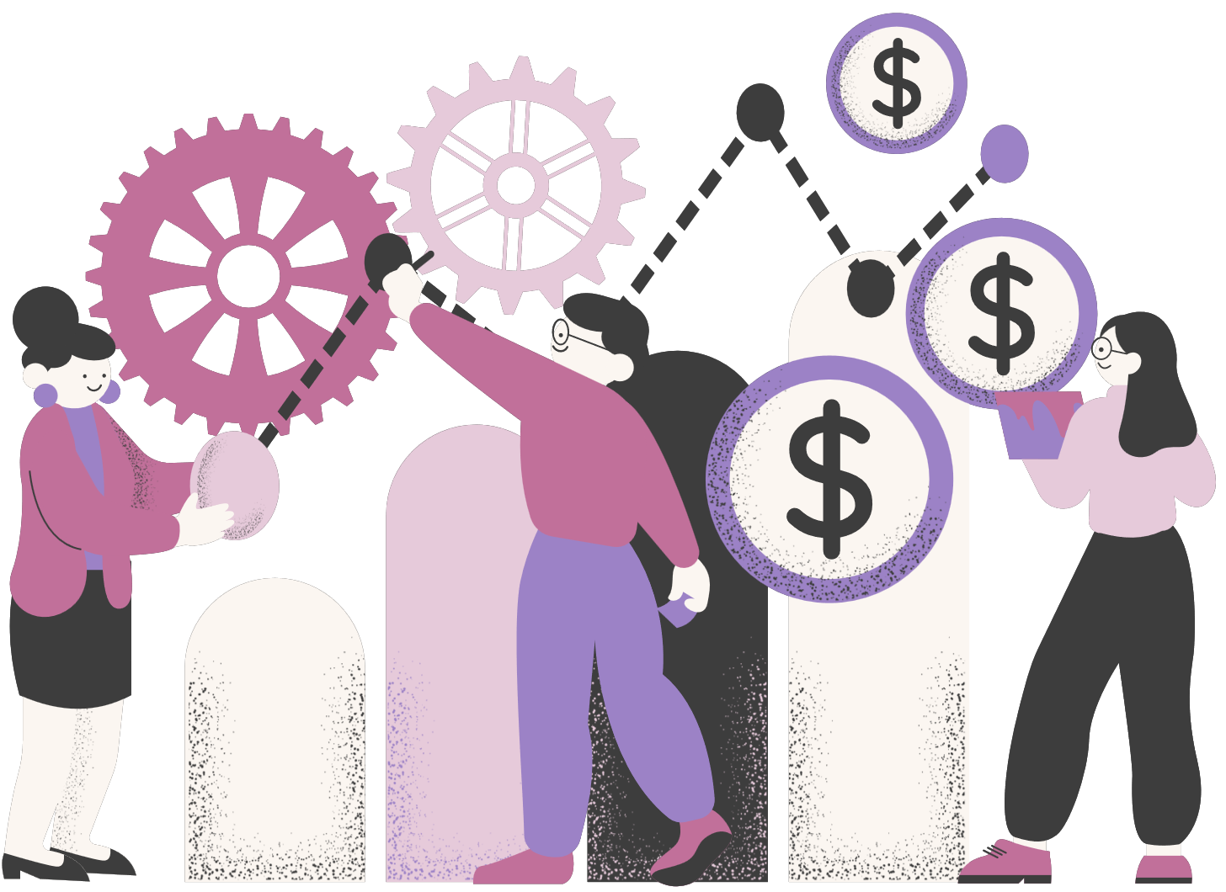
REFERENCES
Ronikdedhia. (2022, August 7). Consumer reviews of Amazon products. Kaggle. https://www.kaggle.com/code/ronikdedhia/consumer-reviews-of-amazon-products
ChatGpt

Slide 8

THANK YOU!

